Slide 1

ORGAN - IZER ONE STOP solution FOR ORGANS AND VACCINE

Slide 2

OUR BIG IDEA
ORGAN-IZER app provides quick and accurate information . This can make a query from people into action , thus saving multiple lives. It gives information about – Various Organ Availability, Organ Transplant Hospitals , Blood Bank details , and Vaccination Availability including COVID-19 Vaccines.

Slide 3
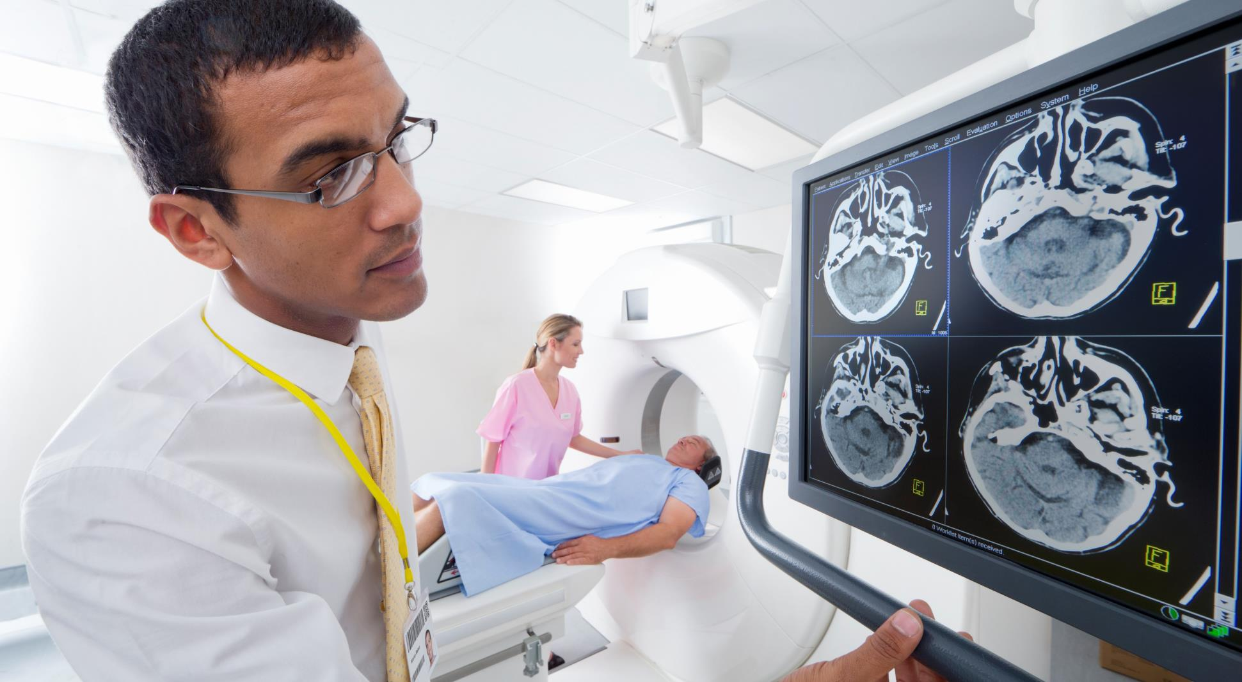




Services offered
Blood & PLASMA DONATION
ORGAN DONATION
HEALTH INFO CHAT BOT
COVID-19 VACCINE PROGRAM REIGSTRATION

Slide 4
TECHNOLOGY USED
REACT JS
NODE JS
ANGULAR , VUE JS
JAVASCRIPT
HTML , CSS
PHP , PYTHON
MYSQL , MONGODB

Slide 5



APPLICATIONS
ORGAN DONATION
BLOOD & PLASMA DONATION
COVID -19 VACCINE REGISTRAION
THE DONOR CAN REGISTER THEMSELVES
THE SYSTEM WILL BE ASKING FOR INFORMATION LIKE WHAT KIND OF DONATION THEY WANT TO DO.
THE PERSON SHOULD BE ABLE TO PROVIDE ALL THEIR DETAILS, MEDICAL REPORTS AND ADRESS PROOFS.
PERSON WHO DONATES BLOOD CAN REGISTER THEMSELVES
THE SYSTEM WILL BE ASKING FOR INFORMATION LIKE WHAT KIND OF BLOOD GROUP THEY BELONGS TO.
THE PERSON SHOULD BE ABLE TO PROVIDE ALL THEIR DETAILS, MEDICAL REPORTS AND ADRESS PROOFS
THE DOCTOR , POLICEMEN, AND FRONTLINE WORKER CAN REGISTER THEMSELVES WITH THEIR PROPER IDENTITY PROOF AND OCCUPATION PROOF.
PRIMARILIY FAMILIES WHERE THERE IS/ARE PEOPLE ABOVE THE AGE OF 60 OR ABOVE CAN REGISTER PROVIDING PROPER AGE PROOF, AS PER THE RULES AND REGULATION OF THE GOVERNMENT.

Slide 6





TARGET USERS
Frontline COVID-19 Warrior
Decision Makers
Donors
Who needs immediate vaccine like Doctors,Policemen, Sanitation Staff
Decision Makers for the Vaccine Program we provide them live updated database
People Who are willing to donate organ , blood or plasma
Senior Citizens / Childern
Urgent Organ Recipients
Primarily for the people who are above 60 years of age, then children below 15 years who needs immediate vaccine
People who are urgent need of any organ for organ transplant, or Blood or plasma to save patient

Slide 7

Thank you
DEEPESH JAMI
PREM KUMAR BAMMIDI
YADHU VAMSI G

